Slide 1
Lab 2
Conceptual modeling

Slide 2
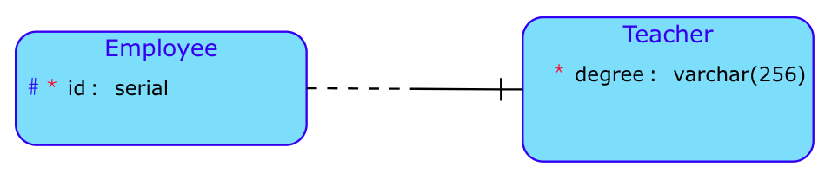
Create conceptual model
Try to make conceptual model of Employee. Employee need to have id as primary key. The Employee may or may not be Teacher. If will be teacher, we need to record teacher degree (must be filled).

Slide 3
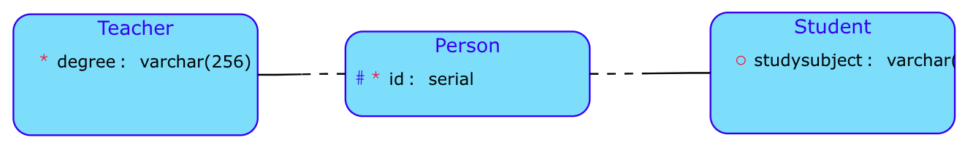
Roles and specialisations
Create entity Person where we need to distinguish:
Teacher
Student
Entity Person will have person_id as primary key.
By the Teacher we will need to record degree (must be filled)
By the Student we will need to record study subject (can be nullable)
A person can be a teacher.
A person can be a student.
A person can be both.
A person does not have to be anything.

Slide 4
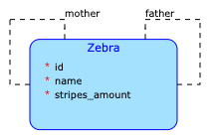
Zebra
Imagine you are want to create simple family trees of Zebras so you define 1:1 relation child-mother and 1:1 relationship child-father.
You’ll create a loop. In order to make sure that data are consistent you should define constraints:
one zebra cannot be mother and father of same child,
child cannot parent (mother or father) of its ancestors.

Slide 5
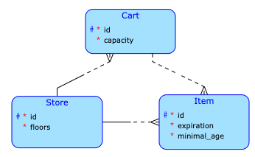
Shop
In this case we are doing some shopping. We have a physical Cart which contains some Items that are available in a Store where we are currently in. At one point there might be multiple people shopping there so one Store has multiple Cart s.
Look at the scheme and answer question - is it possible to be at Store with id = 1 and have in cart items from store with id = 2? The answer is:
no - in a real world. You cannot pay for goods from Store 1 in a Store 2,
yes - when you look on this database scheme. You can simply insert such entry into database and you’ll be in an inconsistent state.
So in this case we must introduce a new constraint that customer can put into Cart only items that are available in the store where shopping is done. Considering this scheme we can also introduce at least one more constraint. Think about it
Note that such constraint is not enforced by database. It must be verified manually in custom function that you’ll write when making the app. Such stuff is not considered in this subject. We just want to know that you are aware of problems that can surface and you know how to solve them.

Slide 6
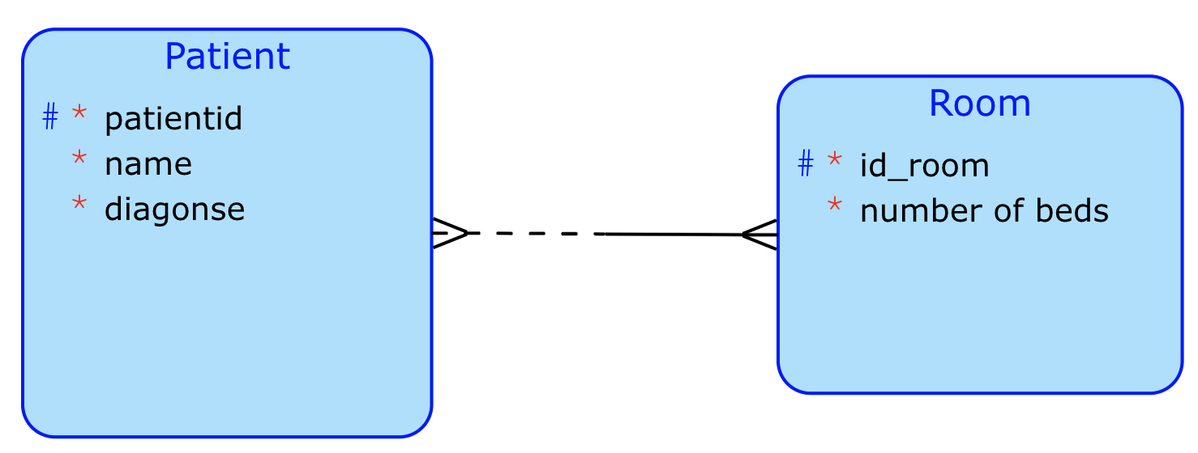
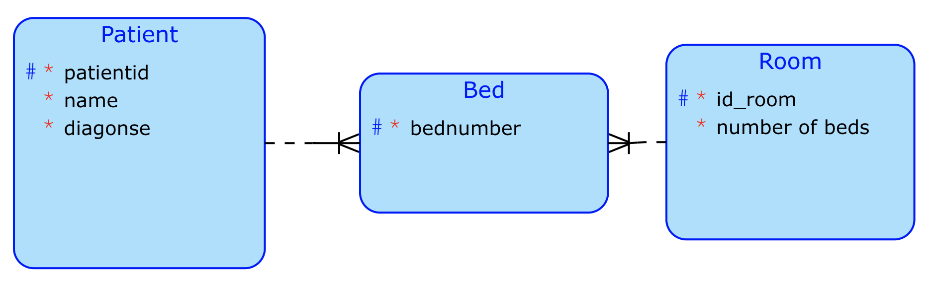
Model this task
Let’s to go make the model a situation where patients are lying in rooms
The customer acknowledges that it is important to know how many bedrooms are in the room, where the patient is lying.
Information about the number of beds in the patient's room can be traced from the relationship between the patient and the room.
Better solution

Slide 7
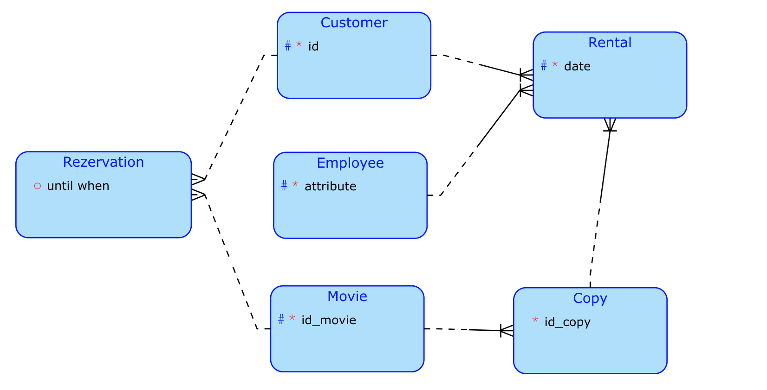
Lets to go to model Video rental shop
The rental company decided to use a computer to keep track of the film cuts.
It records a fact that can be expressed in one sentence as:
Customers borrow films from the rental company's employees.

